Slide 1

Università degli Studi di Milano Bicocca
Scuola di Scienze
Dipartimento di Informatica, Sistemistica e Comunicazione
Corso di laurea in Informatica
Human Skin Detection in Color Images
Relazione della prova finale di:
Michele POZZI
Matricola 845727
Relatore: Prof. Raimondo Schettini
Co-relatore: Dr. Mirko Agarla
Anno Accademico 2020-2021

Slide 2
Scope of Work
The purpose of the thesis is to present a review of the human skin detection datasets and approaches of the state of the art, and then perform a comparative in-depth analysis of the most relevant methods on different databases.

Slide 3
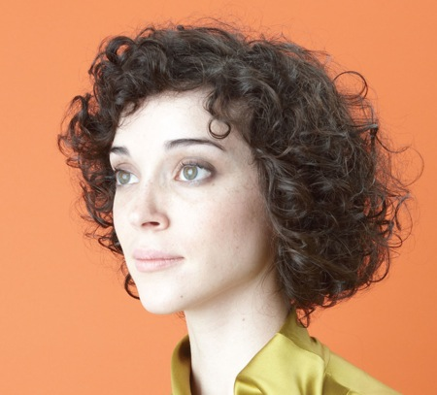
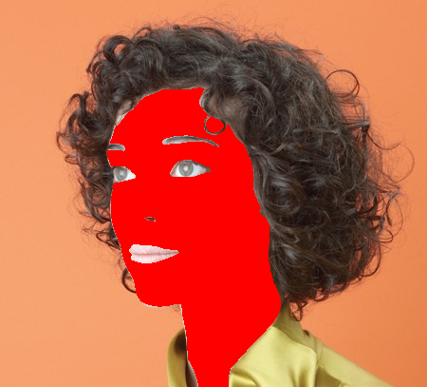
Problem Definition
Skin detection is the process of discriminating skin and non-skin pixels. It is quite a challenging process because of the large color diversity that objects and human skin can assume and the scene properties (illumination, background, …).
Input image with the subject
Segmented image of the subject’s skin

Slide 4
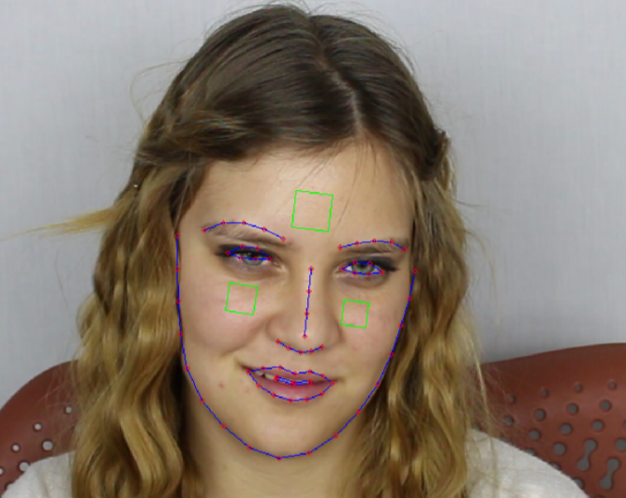
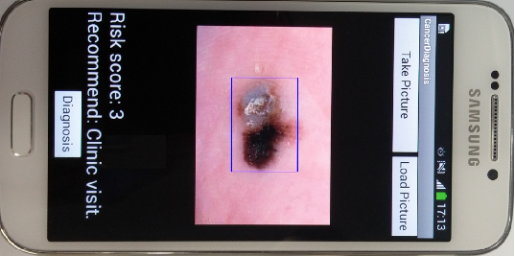
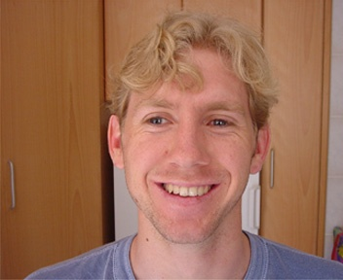
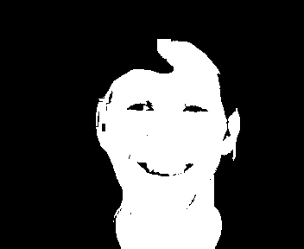
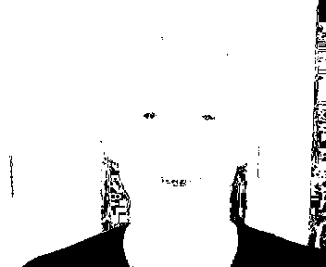
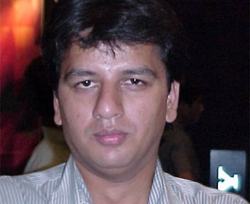

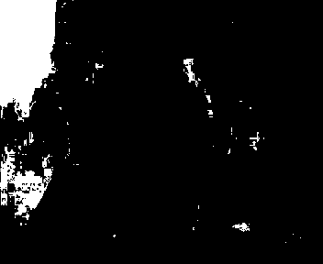
Problem Definition
Applications:
Facial Analysis [1]
Gesture Analysis
Biomedical [2]
Video Surveillance
Content Filter
Advertisement
Limitations: - Materials with skin-like colors - Wide range of skin tones - Illumination
- Cameras color science
Ramirez et al. 2014 [1]
Do et al. 2014 [2]
Wood color is
similar to skin
Lighting changes
skin appareance
Original image
Ground truth
Prediction

Slide 5
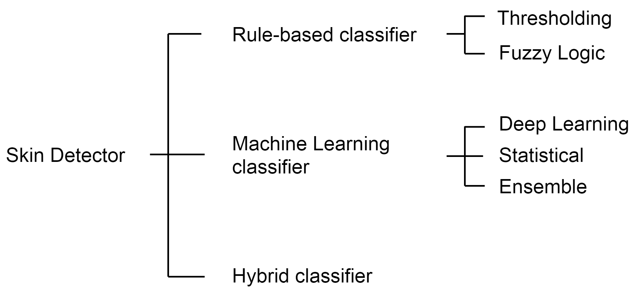
State of the Art
Skin detection is a binary classification problem: the pixels of an image must be divided between skin and non-skin classes.
One of several ways to categorize methods is to group them according to how the pixel classification is done.

Slide 6
State of the Art: Thresholding
Skin detection is a binary classification problem: the pixels of an image must be divided between skin and non-skin classes.
One of several ways to categorize methods is to group them according to how the pixel classification is done.
Thresholding approaches
use plain rules to classify each pixel as either skin or non-skin.
Example:
(Y,Cb,Cr) is a skin pixel if
133<=Cr<=173
77<=Cb<=127

Slide 7
State of the Art: Fuzzy Logic
Skin detection is a binary classification problem: the pixels of an image must be divided between skin and non-skin classes.
One of several ways to categorize methods is to group them according to how the pixel classification is done.
Fuzzy logic approaches
use a set of rules to calculate a combined truth value between 0 and 1. The truth value drives the classification.

Slide 8
State of the Art: Deep Learning
Skin detection is a binary classification problem: the pixels of an image must be divided between skin and non-skin classes.
One of several ways to categorize methods is to group them according to how the pixel classification is done.
Deep learning approaches
use training data to crate a Neural Network model which is then used to perform classification.

Slide 9
State of the Art: Statistical
Skin detection is a binary classification problem: the pixels of an image must be divided between skin and non-skin classes.
One of several ways to categorize methods is to group them according to how the pixel classification is done.
Statistical approaches use training data to crate a statistical model which is then used alongside probability calculus to perform classification.

Slide 10
State of the Art: Ensemble
Skin detection is a binary classification problem: the pixels of an image must be divided between skin and non-skin classes.
One of several ways to categorize methods is to group them according to how the pixel classification is done.
Ensemble approaches use the classifications from different independent machine learning models trained on the same data, as votes for determining the best classification.

Slide 11
State of the Art: Hybrid
Skin detection is a binary classification problem: the pixels of an image must be divided between skin and non-skin classes.
One of several ways to categorize methods is to group them according to how the pixel classification is done.
Hybrid approaches make use of different classification techniques that work together to perform the final classification.

Slide 12
Methodological Approach
Metrics
3 skin tone
sub-datasets
Metrics selection
State-of-the-art
Datasets
categorization
3 representative databases
Single dataset evaluation
+
Cross dataset evaluation
Inference time evaluation
State-of-the-art Methods
categorization
3 representative methods
Validation

Slide 13
Methodological Approach: Selected methods
A thresholding approach has been chosen to demonstrate whether simple rules can achieve powerful results.
A statistical and a deep learning approaches have been chosen to compare how differently the models behave and generalize, and whether the semantic features extraction capabilities of a CNN can have the upper hand.

Slide 14
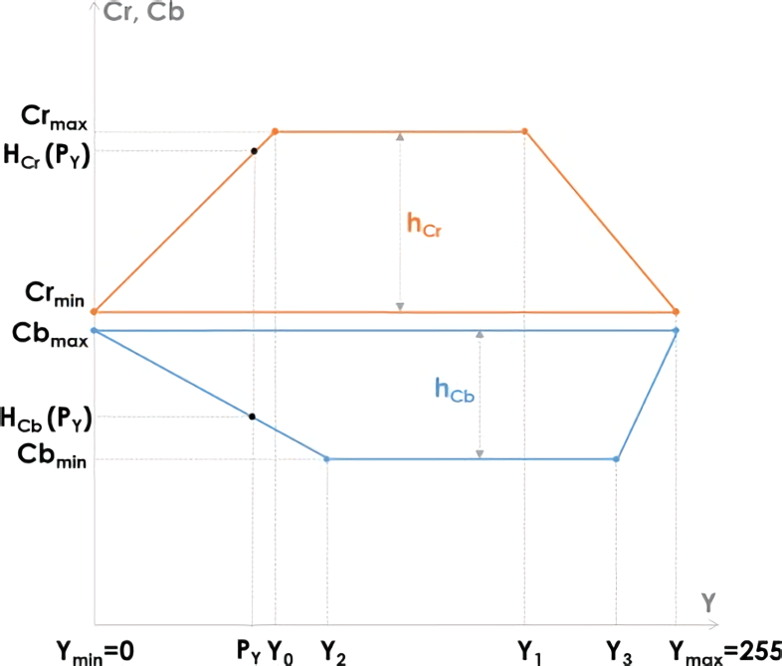
Methodological approach: Rule-based method
Dynamic Thresholding
Brancati et al. 2017 [3]
Input image RGB to YCbCr.
Cr_{max} Cb_{min} computation.
Pixel-wise computation of the correlation of rules parameters.
Pixel-wise correlation rules check.

Slide 15
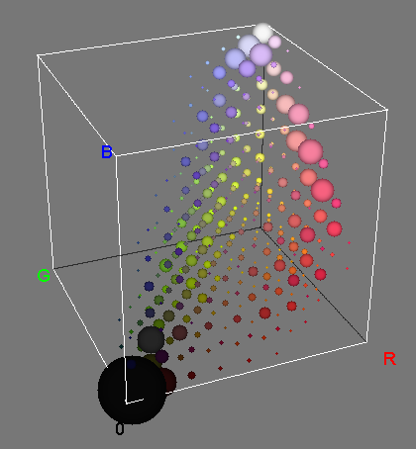
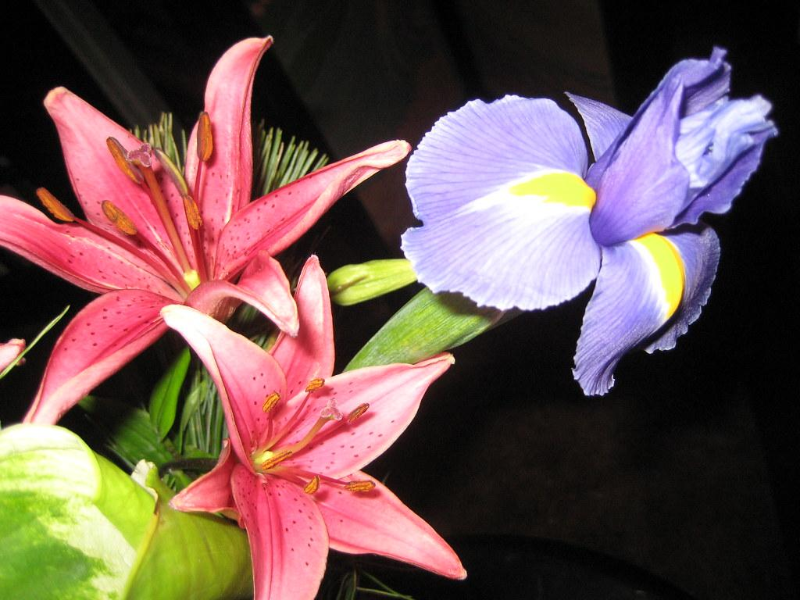
Methodological approach: Machine learning method
Statistical
Training:
Initialize the skin and non-skin 3D histograms.
Pick (image, mask) from the training set.
Loop every rgb pixel from image.
If its mask is a skin pixel, +1 is added to the relative histogram count at coordinates [r,g,b].
Return to step 2 until there are images.
Predicting:
Define classifying threshold Θ.
Loop every rgb pixel from input image.
Calculate rgb probability of being skin.
If skin probability > Θ, it is classified as skin.
Original image
3D histogram representation

Slide 16
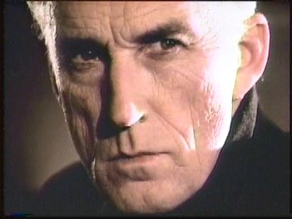
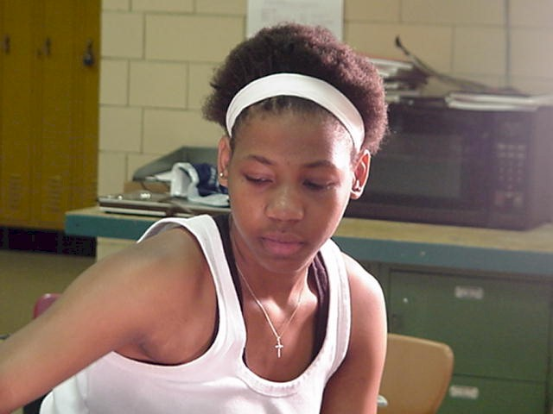
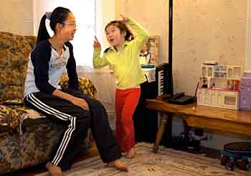
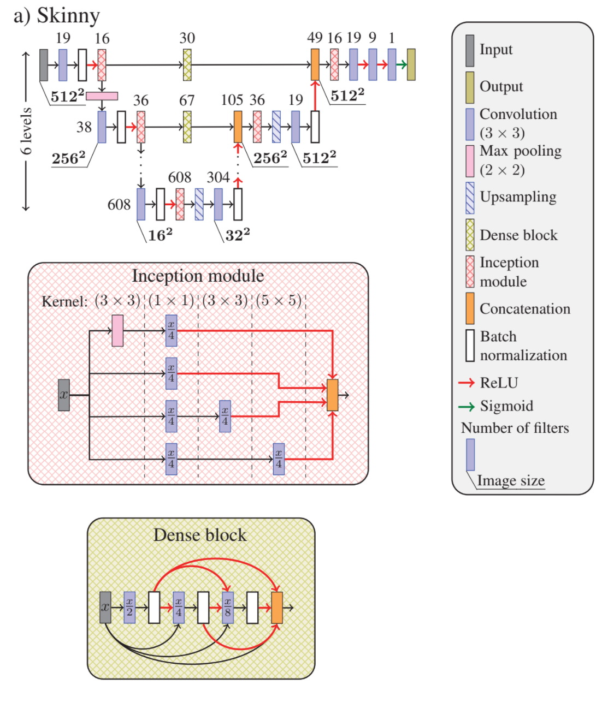
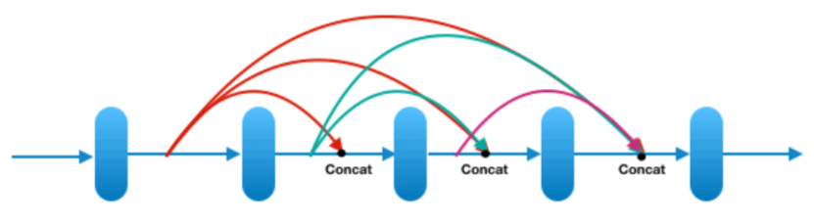
Methodological approach: Deep learning method
U-Net [4]
Workflow:
Pre-process input image: resize (512×512)px, padding.
Extract features in the contracting pathway via convolutions and down-sampling, the spatial information is lost while advanced features are learnt.
Try to retrieve spatial information through the up-sampling of the expansive pathway and the direct concatenations of dense blocks from the contracting pathway.
Provide a final classification map.
Tarasiewicz et al. 2020 [5]
The salient content size varies between images. Inception module combine multiple kernels with different sizes for content adaptation.
Dense block layers are connected in a way that each one receives feature maps from all preceding layers and passes its feature maps to all subsequent layers.

Slide 17
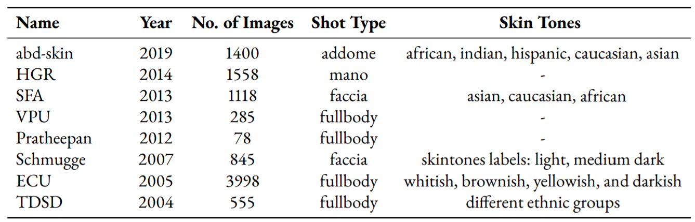
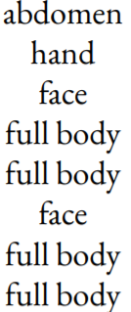
Datasets
Common datasets used in Skin Detection.
Three datasets have been chosen by considering the popularity, diversity, and size of the databases.
* Skin tones are citations from the papers or eventual labels

Slide 18
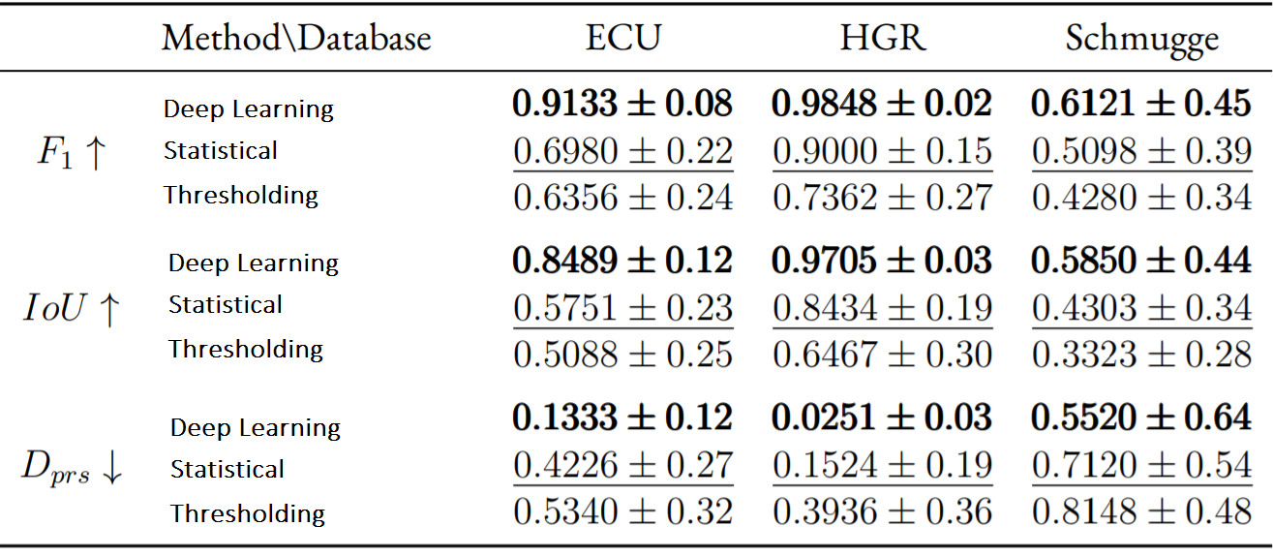
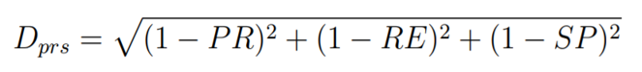
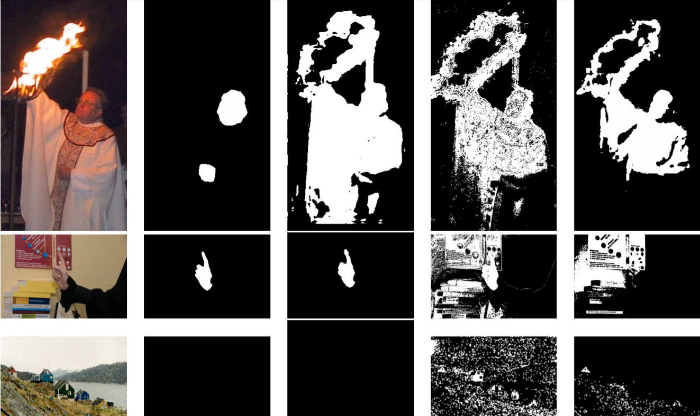
Results: Single dataset evaluation
Schmugge presents high standard deviations that can be attribuited to its diverse content, featuring different subjects, backgrounds, and lighting.
PR - Precision RE - Recall SP - Specificity (1,1,1) - Ideal ground truth
All approaches struggle on this image. The lighting could be the cause.
Color-based method struggle on images without skin pixels and with materials with similar color.
Original Ground truth CNN Statistical Threshold

Slide 19
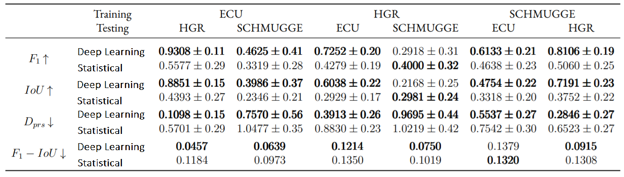
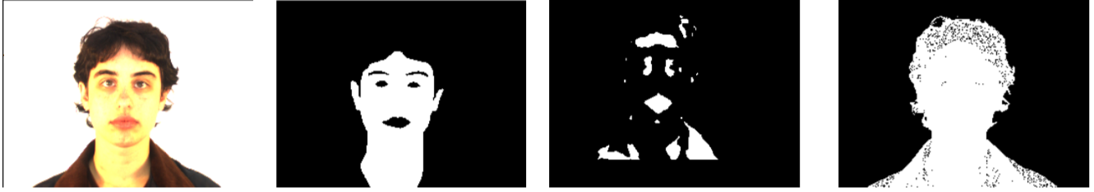
Results: Cross dataset evaluation
The statistical approach outperforms the CNN in these cases, but they are both far away from the ideal ground truths.
The statistical approach may have more False Positives as it loses on Dprs and the difference between F1 and IoU. In this case, the CNN seems to report more False Positives and False Negatives.
Train: HGR
Test: Schmugge
Original Ground truth CNN Statistical
The metric F1 – IoU is taken into consideration to get a better idea of the number of True Positives compared to False Positives and False Negatives.

Slide 20
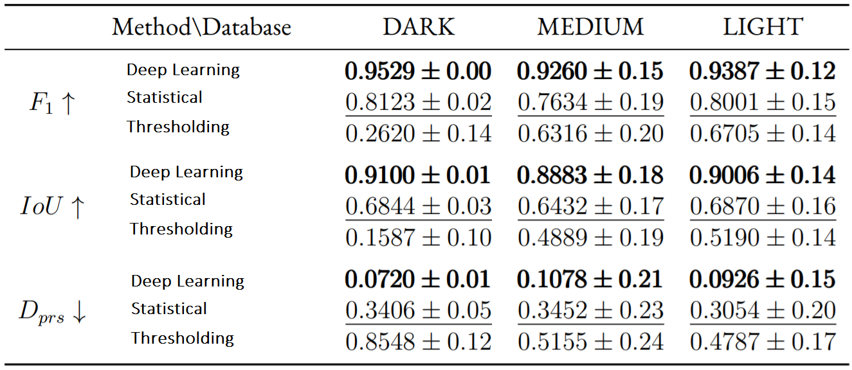
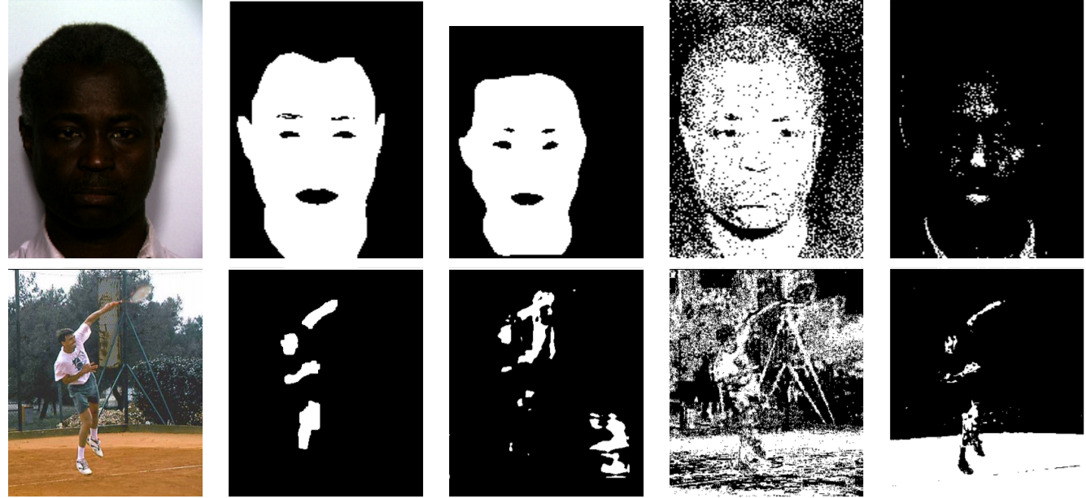
Results: Single skin tones evaluation
The skin tones sub-datasets are taken from the Schmugge dataset, which includes labels. Dark skin tones presented too few images and has been data-augmented to get at least 100 images that look natural. Trasformations applied: - Horizontal Flip - Rotate between -15 and +15 degrees - Random Crop of 0.8 image size
Dark skin tone
Dark presents an almost null standard deviation, indicating that the diversity of the images might not be very high.
The thresholding approach struggles to classify dark skin tones.
Medium skin tone
Original Ground truth CNN Statistical Thresholding

Slide 21
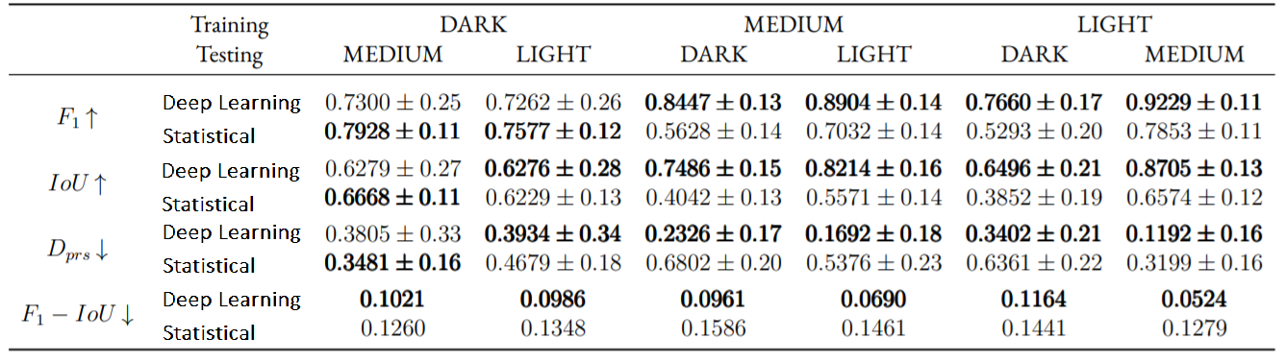
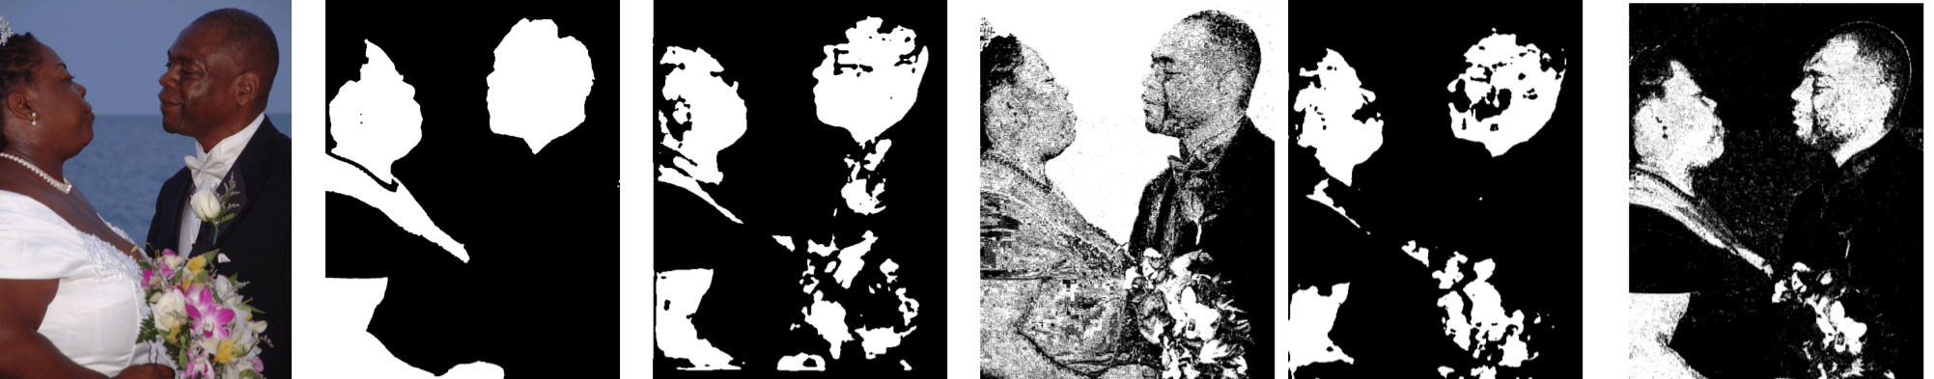
Results: Cross skin tones evaluation
In this case the statistical approach has better F1, but worse IoU: the statistical approach picks more True Positives than the CNN. In Medium on Dark case, the Dprs score of the statistical method is worse than in the case of Light on Dark, even if the F1 and IoU are better.
Specificity is driving the prediction away from the ideal ground truth, suggesting very few True Negatives.
Original Ground truth [MD] CNN [MD] Statistical [LD] CNN [LD] Statistical
[MD] Medium on Dark - Medium as training, Dark as testing
[LD] Light on Dark – Light as training, Dark as testing

Slide 22
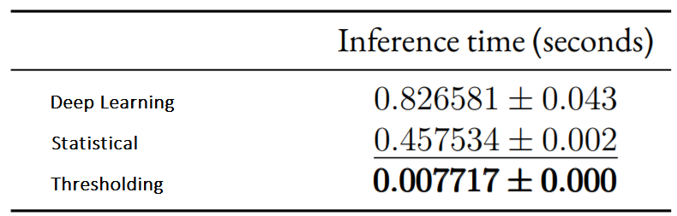
Results: Inference time
The thresholding approach is 65x and 118x times faster than the statistical and the CNN, respectively, achieving 140 FPS. It also has null standard deviation, which highlights the impartiality of the algorithm given different images.
*Measured on a i7 4770k CPU and 16 GB of RAM
The first 14 ECU images, with size of 352×288, have been used as testing dataset. One image at a time has been processed by the methods and the resulting execution time has been saved. The set of pictures has been processed 5 times and, each time, the averaged measurement time has been calculated. Finally, the average values have been averaged into a single value and the standard deviation has been computed.
- Image loading into memory is excluded - Image saving to disk is excluded - The measurement starts when the algorithm starts - Pre-processing and post-processing, if present, are included in the measured execution time

Slide 23
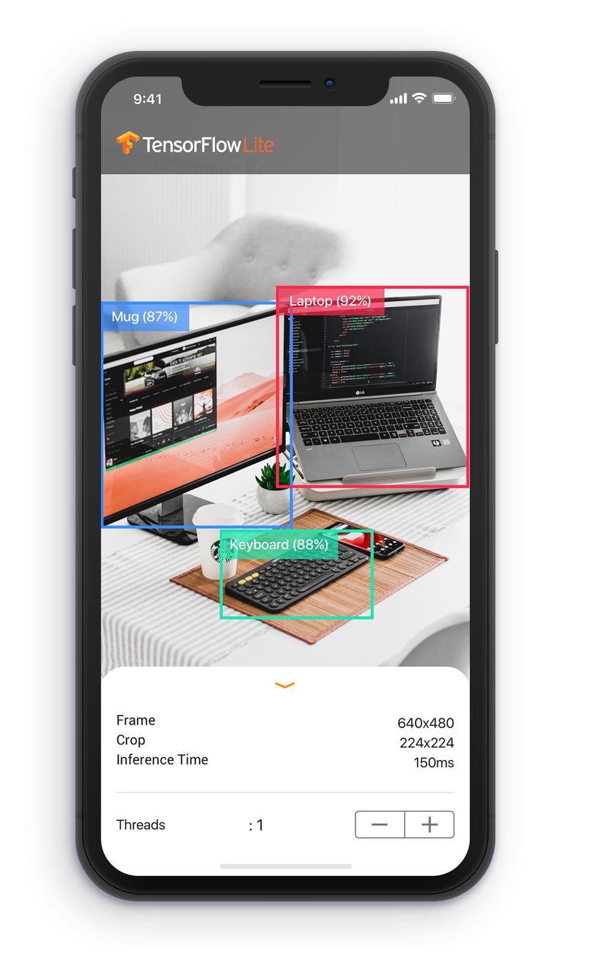
Conclusions and Future Work
In-depth analysis of three main approaches of state-of-the-art
Single and Cross datasets evaluation
Single and Cross skin tones evaluation
Inference Time evaluation
The generalization and semantic features extraction capabilities of CNNs have proven to be really powerful. Thresholding methods had the worst precision but proved to be really fast. Involving multiple metrics have debunked over-optimistic results.
The future work could focus on Transformers, as they have proven to be really successful in Natural Language Processing [6] and are starting to gain traction in the image segmentation tasks [7,8], and mobile Machine Learning, which is becoming a solid platform for U-Nets [9].

Slide 24
References
[1] Ramirez, G. A., Fuentes, O., Crites Jr, S. L., Jimenez, M., & Ordonez, J. (2014). Color analysis of facial skin: Detection of emotional state. In Proceedings of the IEEE Conference on Computer Vision and Pattern Recognition Workshops (pp. 468-473). [2] Do, T. T., Zhou, Y., Zheng, H., Cheung, N. M., & Koh, D. (2014, August). Early melanoma diagnosis with mobile imaging. In 2014 36th Annual International Conference of the IEEE Engineering in Medicine and Biology Society (pp. 6752-6757). IEEE. [3] Brancati, N., De Pietro, G., Frucci, M., & Gallo, L. (2017). Human skin detection through correlation rules between the YCb and YCr subspaces based on dynamic color clustering. Computer Vision and Image Understanding, 155, 33-42. [4] Ronneberger, O., Fischer, P., & Brox, T. (2015, October). U-net: Convolutional networks for biomedical image segmentation. In International Conference on Medical image computing and computer-assisted intervention (pp. 234-241). Springer, Cham. [5] Tarasiewicz, T., Nalepa, J., & Kawulok, M. (2020, October). Skinny: A Lightweight U-net for Skin Detection and Segmentation. In 2020 IEEE International Conference on Image Processing (ICIP) (pp. 2386-2390). IEEE.
[6] Devlin, J., Chang, M. W., Lee, K., & Toutanova, K. (2018). Bert: Pre-training of deep bidirectional transformers for language understanding. arXiv preprint arXiv:1810.04805. [7] Chen, J., Lu, Y., Yu, Q., Luo, X., Adeli, E., Wang, Y., ... & Zhou, Y. (2021). Transunet: Transformers make strong encoders for medical image segmentation. arXiv preprint arXiv:2102.04306. [8] Cao, H., Wang, Y., Chen, J., Jiang, D., Zhang, X., Tian, Q., & Wang, M. (2021). Swin-Unet: Unet-like Pure Transformer for Medical Image Segmentation. arXiv preprint arXiv:2105.05537. [9] Ignatov, A., Byeoung-su, K., Timofte, R., & Pouget, A. (2021). Fast camera image denoising on mobile gpus with deep learning, mobile ai 2021 challenge: Report. In Proceedings of the IEEE/CVF Conference on Computer Vision and Pattern Recognition (pp. 2515-2524).

Slide 25
Thanks for the attention!

